Slide 1


Import, Export, and transfer data with Navicat
Navicat Certified Database Administrator - Associate

Slide 2

HKIIT - Navicat Certified Database Administrator - Associate
Lessons Intended Learning Outcome
On completion of this lesson(s), students are expected to be able to:
(#1) Generating Test Data
(#2) Back up a database for restoring later
(#3) Create and schedule batch jobs

Slide 3
HKIIT - Navicat Certified Database Administrator - Associate
Learning Outline
Navicat’s test data generation capability
Best practices of data backup and restore
Batch job

Slide 4
HKIIT - Navicat Certified Database Administrator - Associate
DATA GENERATION
Mock Data Generation
Mock data refers to synthetic data that is created to simulate real-world data. Naicate’s mock data generation feature is designed to generate data with expected format and contains meaningful values for testing purposes.
Always ensure you have a backup of your database before initiating data generation.

Slide 5

DATA GENERATION
Risk of using production data
Production data is information that is persistently stored and used to conduct day-to-day business tasks and processes.
Contain privacy-sensitive or personally identifiable information
Need to mask the privacy-sensitive data to comply with privacy regulations like GDPR, PCI, and HIPAA.
HKIIT - Navicat Certified Database Administrator - Associate

Slide 6
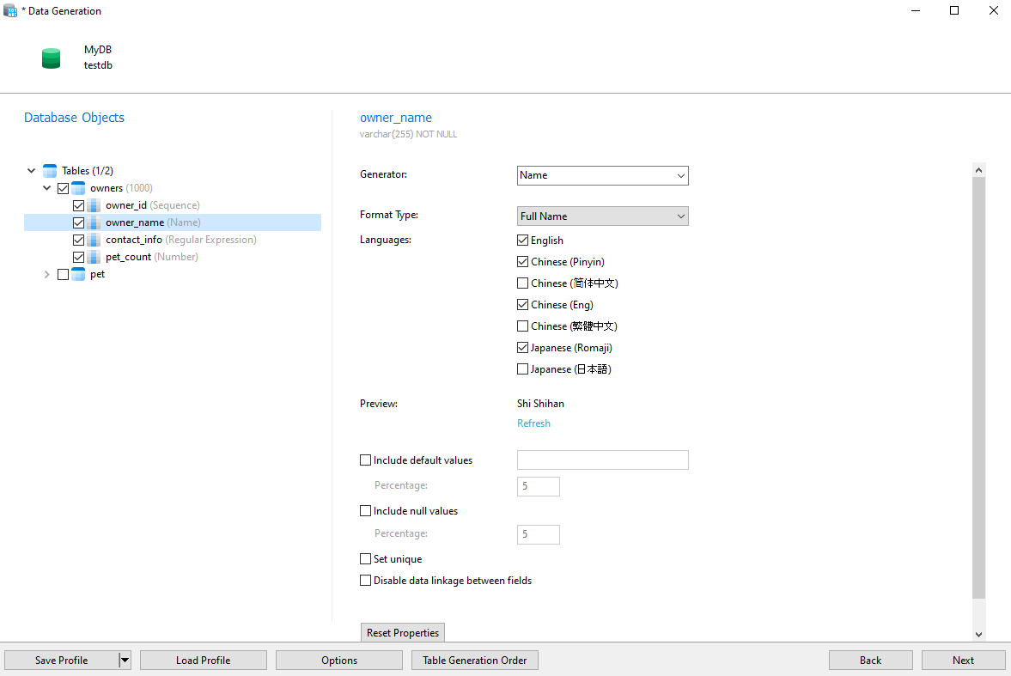
DATA GENERATION
Producing realistic mock data with Navicat
It's essential to define the mock data types and formats for each column.
It can produce a wide range of fake data in multiple languages.
HKIIT - Navicat Certified Database Administrator - Associate

Slide 7
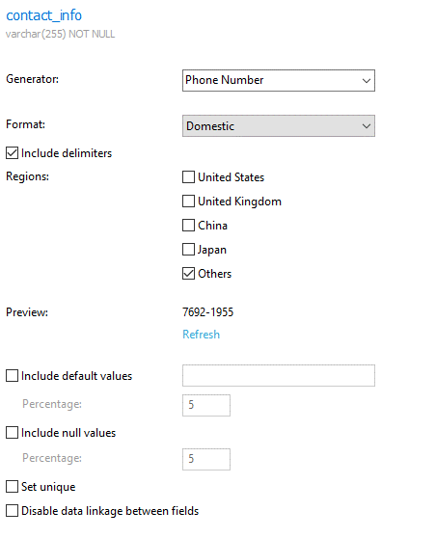
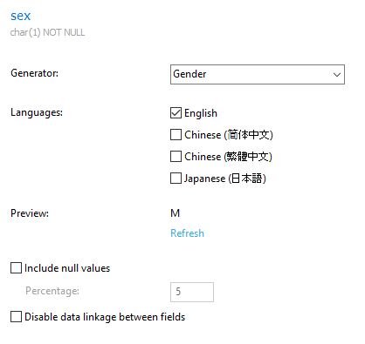
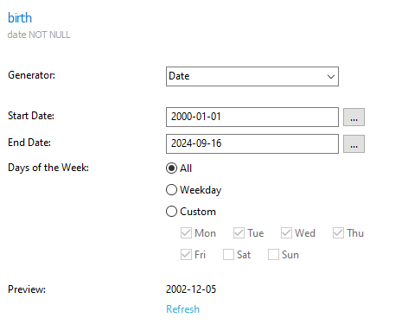
DATA GENERATION
Data Generators
Phone Number Generator
Gender Generator
Date/Time Generator
How to use Number Generator in Navicat Data Generation?
HKIIT - Navicat Certified Database Administrator - Associate

Slide 8
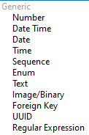
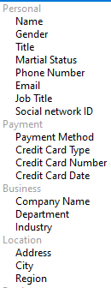
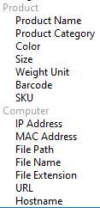
DATA GENERATION
Data Generators
Multiple built-in generators available with the ability to create custom data generators.
HKIIT - Navicat Certified Database Administrator - Associate

Slide 9
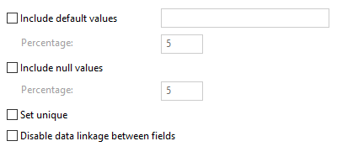
DATA GENERATION
Option Setting of Data Generation
Option | Description
Include default values | Generate default values. You can set the default value of the column, and set the Percentage of the default values in the column.
Include null values | Generate NULL values. You can set the Percentage of Null values in the column.
Set unique | Make the values generated for the column unique.
Convert value to | Convert the values to lower case, upper case or proper case (the first letter in each word is capitalized, the other letters are lower case).
Disable data linkage between fields | Unlink the data between this field with other fields. If this option is unchecked, Navicat will generate data with linkage between fields. Example: If the name field is "Robert Rose", the email field will be like "robertrose@outlook.com".
HKIIT - Navicat Certified Database Administrator - Associate

Slide 10
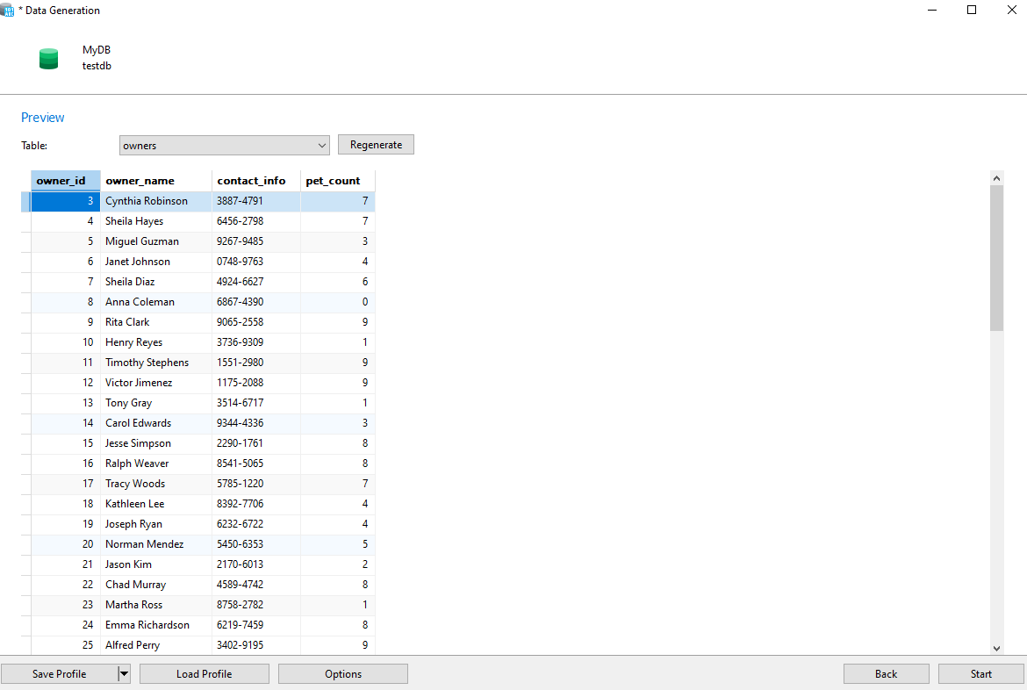
DATA GENERATION
Mock Data Preview
Show us a preview of what the generated data will look like for each table that we selected.
We can manually change values or Regenerate all data for a table.
Once we're satisfied with the data we can generate it by clicking the Start button.
HKIIT - Navicat Certified Database Administrator - Associate

Slide 11
HKIIT - Navicat Certified Database Administrator - Associate
BACKUP & RESTORE
Backup and Restore
Backing up and restoring your database in Navicat is indeed crucial to prevent data loss due to unexpected events like hardware failures or user errors.
Navicat lets you back up all Tables (and their records), Views, Functions, and Events of your database for restoring later.

Slide 12
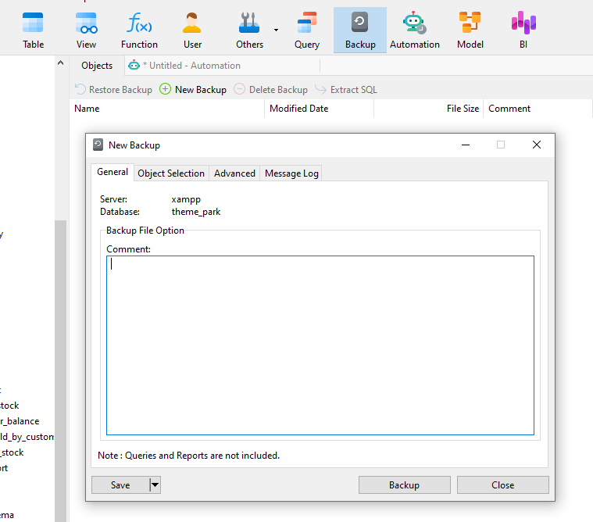
BACKUP
Backup entry database
Click the Backup button on the object pane toolbar
Click ‘New Backup ’ button to create a new backup
In the backup properties window, you can make your own comment for the backup file in this general tab.
HKIIT - Navicat Certified Database Administrator - Associate

Slide 13
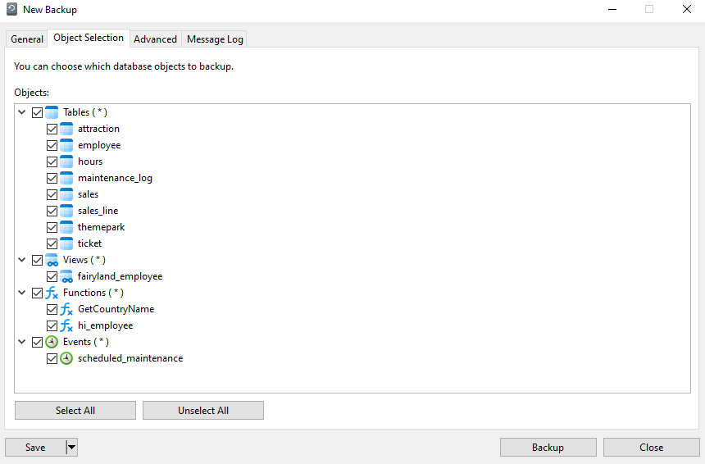
BACKUP
Backup entry database
Select Objects to backup
HKIIT - Navicat Certified Database Administrator - Associate

Slide 14
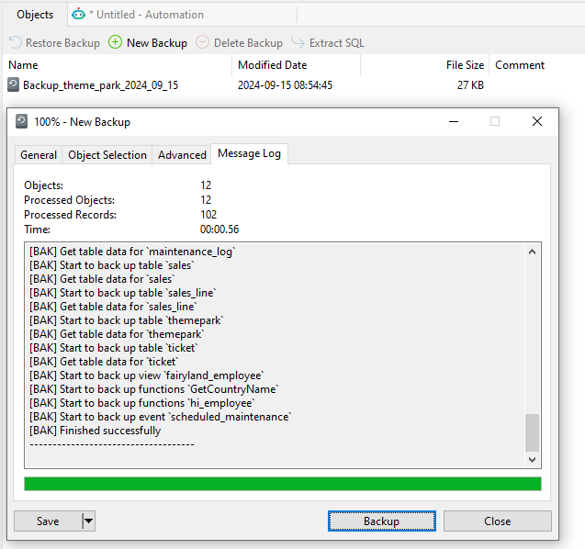
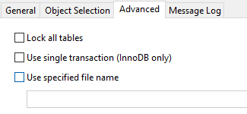
BACKUP
Backup entry database
Advanced setting
HKIIT - Navicat Certified Database Administrator - Associate

Slide 15
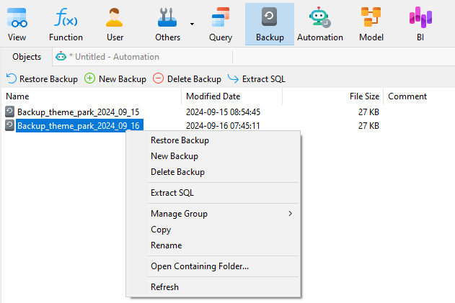
BACKUP
Manage Backup Files
To delete a Backup, right-click on the unwanted backup and select Delete Backup.
Extract SQL scripts from a backup file, by selecting the Extract SQL
Backups are saved as single files in a hierarchy of subfolders under My Documents by default.
HKIIT - Navicat Certified Database Administrator - Associate

Slide 16
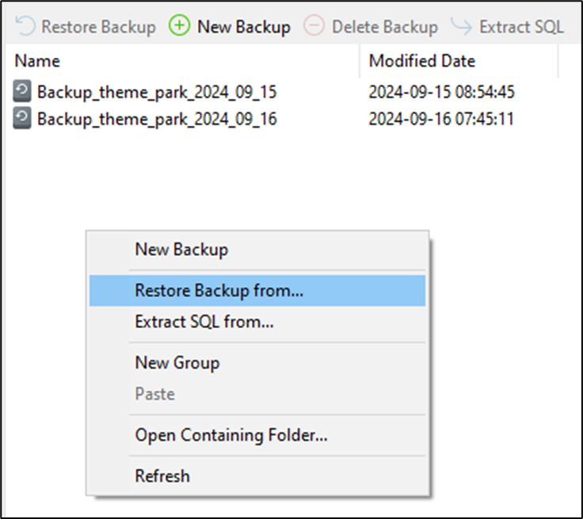
RESTORE
Restoring a Backup
From the List
From Another Machine
Right-click on a backup and select Restore Backup from the pop-up menu
Right-click on an empty area of the object pane select Restore Backup from the pop-up menu, and choose the backup file from the dialog box.
HKIIT - Navicat Certified Database Administrator - Associate

Slide 17
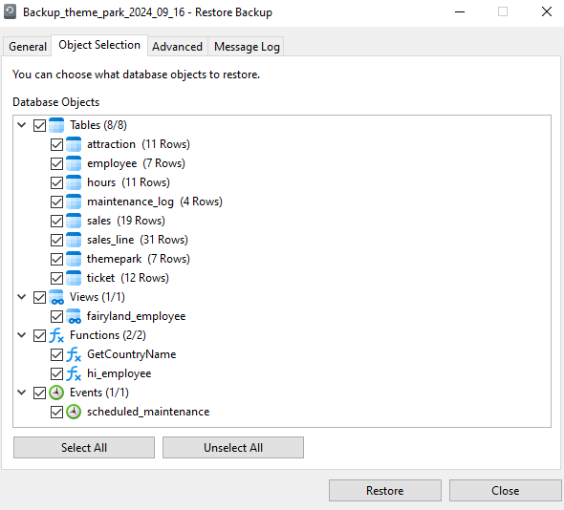
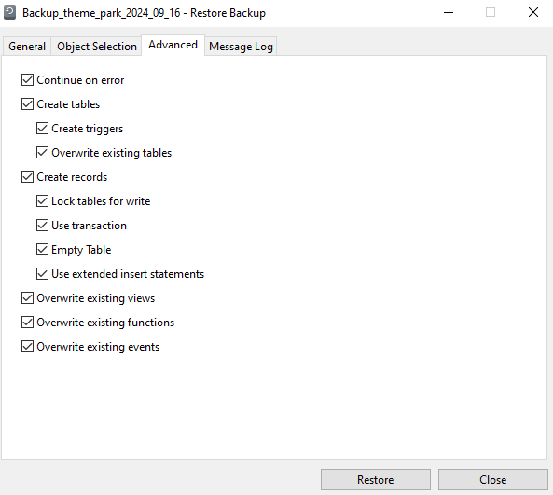
RESTORE
Restoring a Backup
HKIIT - Navicat Certified Database Administrator - Associate

Slide 18
HKIIT - Navicat Certified Database Administrator - Associate
BACKUP & RESTORE
Configuring Automated Backups in Navicat
Backing up and restoring your database in Navicat is indeed crucial to prevent data loss due to unexpected events like hardware failures or user errors.
Navicat lets you back up all Tables (and their records), Views, Functions, and Events of your database for restoring later.

Slide 19
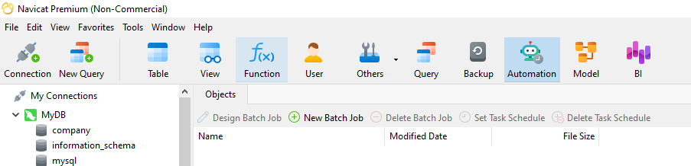
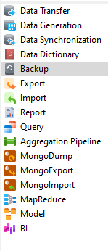
AUTO JOB
Automation: Batch Job
In the main window, click Automation to open the automation object list.
Batch jobs can be created for Backup, Restore Backup, Data Transfer, Import and Export.
You can define a list of jobs to be performed within one batch job, either run it manually, at the specified time or periodically.
HKIIT - Navicat Certified Database Administrator - Associate

Slide 20
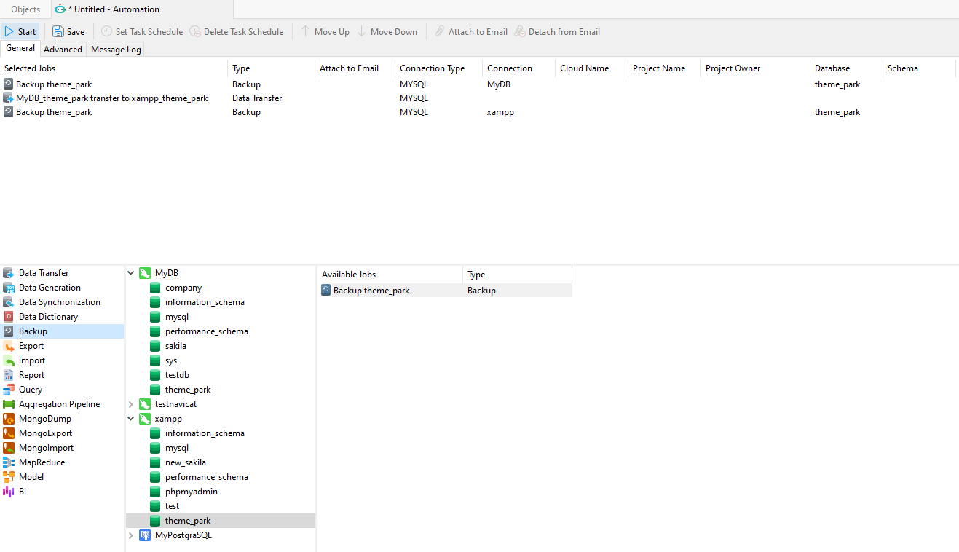
AUTO JOB
Automation: Batch Job – Backup data
If you want to backup whole server, you can select the connection and select Backup Server.
HKIIT - Navicat Certified Database Administrator - Associate

Slide 21
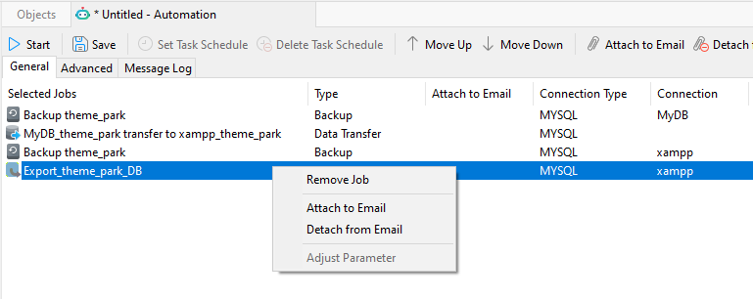
AUTO JOB
Automation: Batch Job – Export Data
Exported files or printed reports can be added to the batch job as mail attachments.
Select the job in the Selected Jobs list and click Add Attachment or Remove Attachment to manage mail attachments.
HKIIT - Navicat Certified Database Administrator - Associate

Slide 22
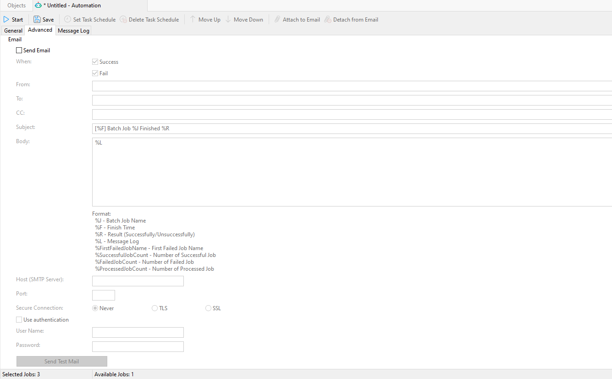
AUTO JOB
Automation: Email Notifications
Check the Send Email option in the Advanced tab and enter the required information.
HKIIT - Navicat Certified Database Administrator - Associate

Slide 23
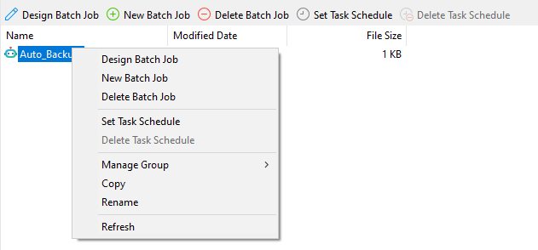
AUTO JOB
Managing Automation
Click `Design Batch Job` to edit the job list for the created batch job.
Click `Set Task Schedule` to set schedule for running a batch job.
HKIIT - Navicat Certified Database Administrator - Associate

Slide 24
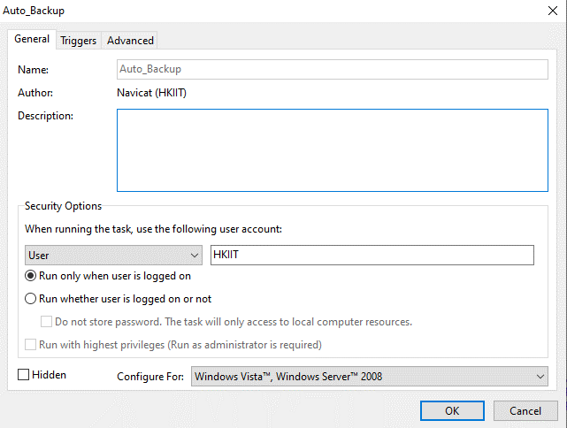
AUTO JOB
Automation: Setting Task Schedule
If you choose Run whether user is logged on or not in the General tab, then you must provide your OS user password in Windows Scheduler when you save the schedule.
HKIIT - Navicat Certified Database Administrator - Associate

Slide 25
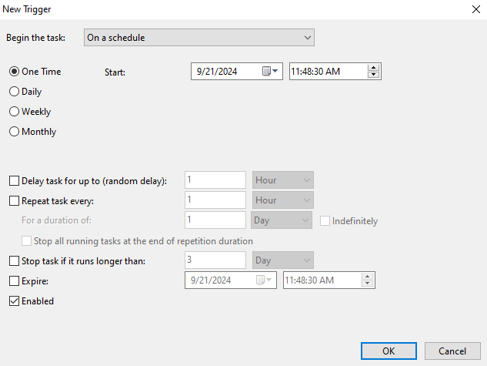
AUTO JOB
Automation: Setting Task Schedule
Set schedule for running your batch job at a specific time or day.
HKIIT - Navicat Certified Database Administrator - Associate

Slide 26

Navicat
Data Generation, Backup and Restore
We explored key database management tasks using Navicat. We now understand how to utilize Navicat’s visual tools to generate large volumes of test data for development and testing, create comprehensive database backups to safeguard against data loss, and restore databases seamlessly from backup files.
HKIIT - Navicat Certified Database Administrator - Associate

